Slide 1


Economics of Moving Local Healthcare
From Wall Street to Main Street

Slide 2

Direct-to-Employer Strategy: Only Available to Premier Health Systems
STRONG Brand Quality
EXTENSIVE Patient Access
AFFORDABLE Value Pricing
EXCELENT Care Quality

Slide 3
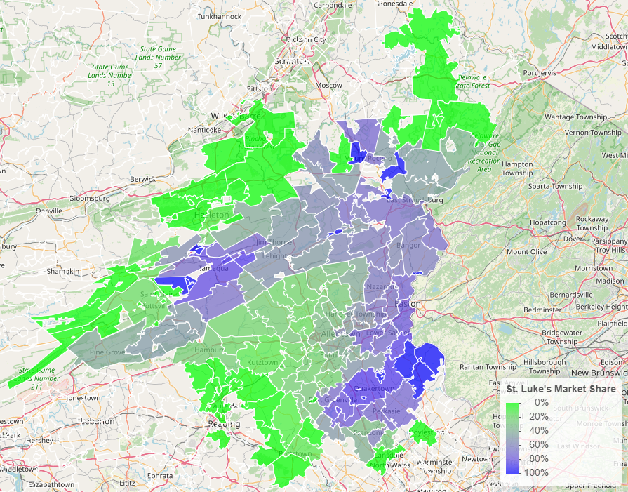


SLUHN Advantage: Strong Brand Quality
Comparison of Medicare payment market share by zip code: St Luke’s vs Lehigh Valley Health Network

Slide 4
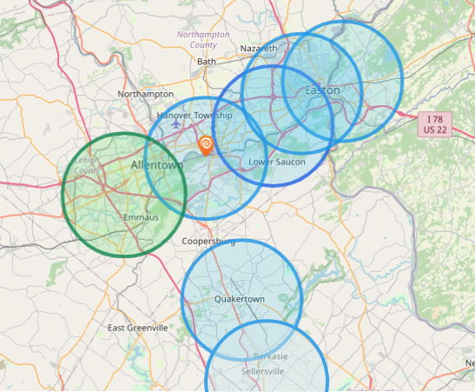
SLUHN Advantage: Best-in-Area Patient Access
Hospital | Population Within 5 Miles
St Luke's Hospital - Anderson Campus | 142,000
St Lukes Upper Bucks Campus | 46,000
St Luke's Hospital Bethlehem | 255,000
St Luke's Warren Hospital | 118,000
St Luke's Hospital - Easton Campus | 141,000
St. Luke’s Hospital Monroe County | 48,667
St. Luke’s Hospital Carbon County | 26,628
Grand View Hospital | 70,739
Hospital | Population Within 5 Miles
Lehigh Valley Hospital Cedar Crest | 227,393

Slide 5

SLUHN Advantage: Leading Care Quality
Patient HCAHPS Recommendation Rate Percentile | CMS Quality Stars Percentile | Mortality Average Percentile | Readmission Percentile
73% | 99% | 86% | 63%
53% | 58% | 72% | 63%
Source: CMS measurements of HCAHPS patient experience (percent who would strongly recommend), CMS Stars, high-variation mortality rates and high-variation readmission rates all shown as percentiles compared to all hospitals nationally, with the 99th percentile being the best.

Slide 6
SLUHN Advantage: Care at Value Pricing
Hospital | Rand Outpatient Services Percent of Medicare | Rand Inpatient Services Percent of Medicare
St Luke's Hospital - Anderson Campus | 290% | 280%
St Lukes Upper Bucks Campus | 292%
St Luke's Hospital Bethlehem | 287% | 214%
St Luke's Warren Hospital | 251%
St Luke's Hospital - Easton Campus | 212%
St Luke’s Hospital - Monroe County | 251% | 219%
Grand View Hospital | 179% | 197%
Lehigh Valley Hospital Cedar Crest | 315% | 249%
Source: RAND round 5 hospital cost data: https://www.rand.org/pubs/research_reports/RRA1144-2.html

Slide 7

Community
Plan
Control
Transformation
$
Margin
$
Volume/Profit
Steerage to SLUHN
Beneficial Pricing

Slide 8
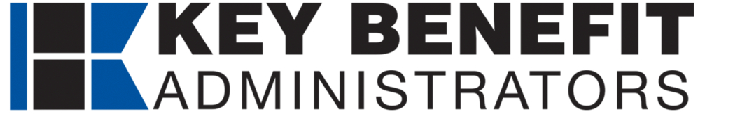
Traditional Volume-Based DTE
Year | Target Employees | Target Members
1 | 500 | 1,000
2 | 1,100 | 2,000
3 | 1,800 | 3,200
4 | 2,800 | 5,000
5 | 4,100 | 7,400
6 | 5,700 | 10,300
7 | 7,800 | 14,000
8 | 10,300 | 18,500
9 | 13,500 | 24,300
10 | 17,300 | 31,100
11 | 21,600 | 38,900
12 | 26,400 | 47,500
13 | 31,400 | 56,500
14 | 36,400 | 65,500
15 | 41,200 | 74,200
16 | 45,600 | 82,100
17 | 49,400 | 88,900
18 | 52,600 | 94,700
19 | 55,200 | 99,400
20 | 57,200 | 103,000
21 | 58,700 | 105,700
22 | 59,800 | 107,600
23 | 60,700 | 109,300
24 | 61,300 | 110,300
25 | 61,800 | 111,200
Early Stage
Gaining Name Recognition, Early Growth
New Revenue:
New Profit:
$15.31M
$1.73M
Growth Stage
Strong Reputation, Strong Growth
New Revenue:
New Profit:
$106.68M
$13.26M
Mature Stage
High Profitability, Market Saturation
New Revenue:
New Profit:
$212.54M
$26.58M

Slide 9
Margin-Focused DTE
Year | Target Employees | Target Members
1 | 100 | 200
2 | 200 | 400
3 | 300 | 500
4 | 400 | 700
5 | 600 | 1,100
6 | 900 | 1,600
7 | 1,200 | 2,200
8 | 1,600 | 2,900
9 | 2,100 | 3,800
10 | 2,600 | 4,700
11 | 3,300 | 5,900
12 | 4,000 | 7,200
13 | 4,800 | 8,600
14 | 5,500 | 9,900
15 | 6,300 | 11,300
16 | 6,900 | 12,400
17 | 7,500 | 13,500
18 | 8,000 | 14,400
19 | 8,400 | 15,100
20 | 8,700 | 15,700
21 | 8,900 | 16,000
22 | 9,100 | 16,400
23 | 9,200 | 16,600
24 | 9,300 | 16,700
25 | 9,400 | 16,900
Early Stage
Gaining Name Recognition, Early Growth
New Revenue:
New Profit:
$2.55M
$0.37M
Growth Stage
Strong Reputation, Strong Growth
New Revenue:
New Profit:
$17.78M
$3.75M
Mature Stage
High Profitability, Market Saturation
New Revenue:
New Profit:
$35.42M
$7.63M

Slide 10
State-Wide DTE
Early Stage
Gaining Name Recognition, Early Growth
Year | Employees | Members
1 | 9,100 | 20,020
2 | 18,300 | 40,260
3 | 27,600 | 60,720
4 | 38,200 | 84,040
5 | 49,600 | 109,120
6 | 61,300 | 134,860
7 | 72,900 | 160,380
8 | 83,600 | 183,920
9 | 93,200 | 205,040
10 | 101,400 | 223,080
New Revenue:
New Profit:
$0M
$0M
Growth Stage
Strong Reputation, Strong Growth
New Revenue:
New Profit:
$0M
$0M
Mature Stage
High Profitability, Market Saturation
Target of reaching 20% of the population in 10 years.
New Revenue:
New Profit:
$0M
$0M

Slide 11
Per-Member Medical Spend in Maine
Health System/Group | Inpatient Market Share | Outpatient Market Share | Inpatient Dollars | Outpatient Dollars
MaineHealth | 53% | 21% | $ 1,130 | $ 1,214
Northern Light Health | 24% | 14% | $ 502 | $ 800
Central Maine Healthcare | 7% | 4% | $ 141 | $ 243
MaineGeneral Health | 7% | 5% | $ 151 | $ 275
Other Standalone Hospitals | 5% | 7% | $ 97 | $ 374
Covenant Health | 4% | 4% | $ 93 | $ 213
DECH and CCH | 0% | 1% | $ 8 | $ 55
Independent Ambulatory |  | 44% |  | $ 2,484
PMPY Commercial
Medical
Inpatient/Ambulatory
Spend*
$7,779
*Number is derived from KBA data warehouse, drawing from over $3B in yearly adjudicated charges to estimate PMPY spend by inpatient, outpatient and professional charges. Pharmacy and non-health-system charges are excluded.
Using the Milliman area adjustment factors by zip code, charges are standardized to local estimates.
These estimated charges are conservative as KBA claims average ~15% below the market average.

Slide 12
The Impact of Just 1% Price or Net Collections Improvement
Health System/Group | Commercial Margin | Government Margin | Commercial Per-Member Net Income | Revenue Impact of 1% Price Improvement Per 100K Members | Net Income Impact of 1% Price Improvement Per 100K Members
MaineHealth | 15% | -111% | $352 | $2,343,835 | $351,575
Northern Light Health | 27% | -127% | $351 | $1,301,673 | $351,452
Central Maine Healthcare | 23% | -175% | $88 | $384,647 | $88,469
MaineGeneral Health | 35% | -222% | $149 | $425,718 | $149,001
Other Standalone Hospitals | 36% | -117% | $170 | $470,911 | $169,528

Slide 13
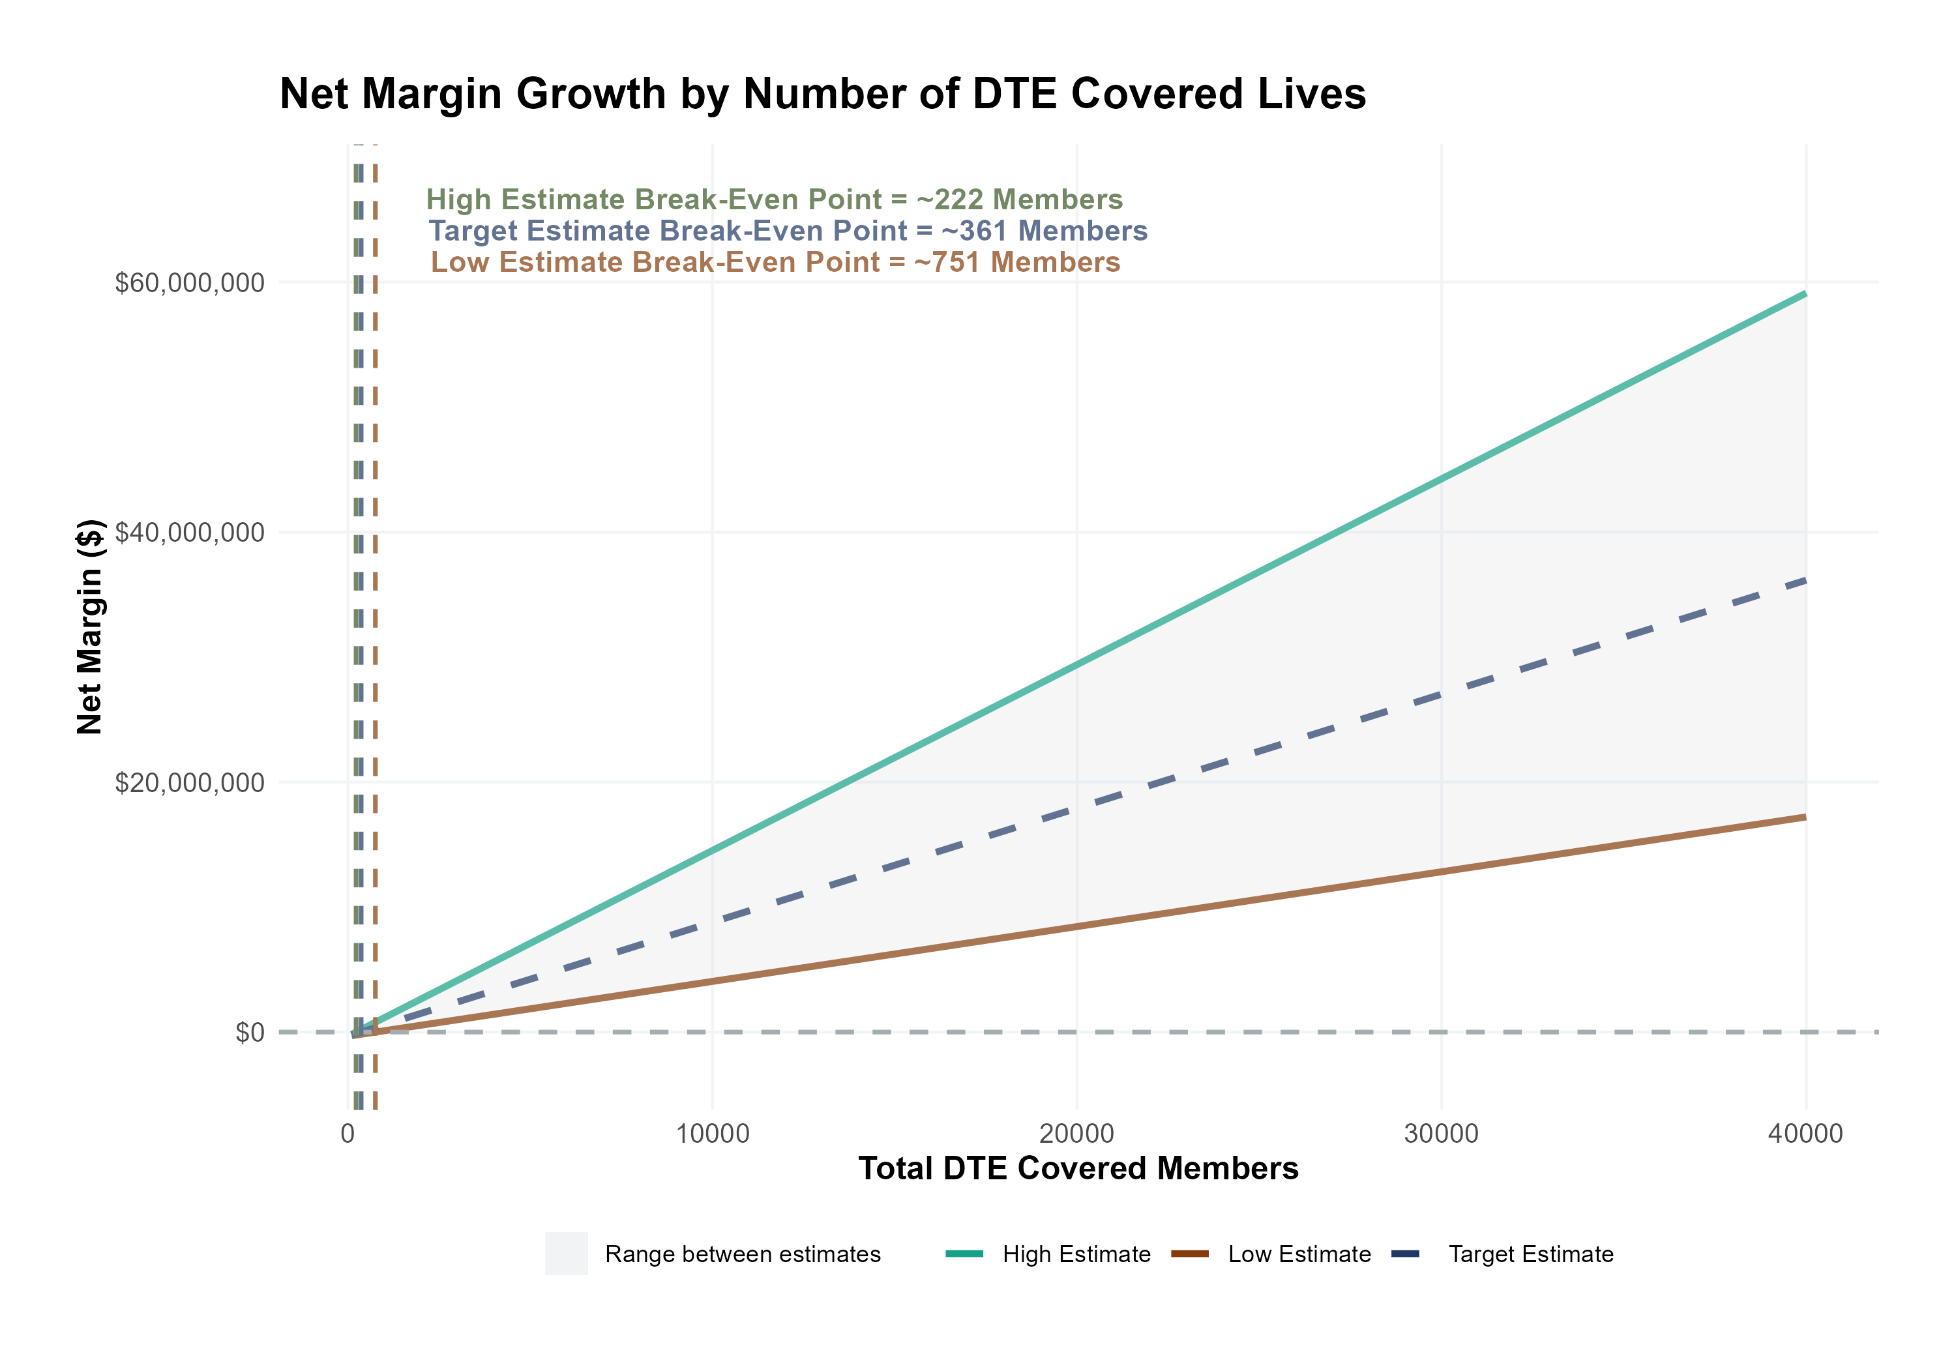
Estimated Financial Returns and Assumptions
Patient Steerage Assumptions
KBA currently estimates that MaineHealth has 50% inpatient market share, and 19% outpatient market compared to hospitals/clinics in Western and Central Maine. The DTE tiered structure will create immediate steerage, with additional steerage over time from patient bonus benefits and the patient card (see slide 33 for estimates of target steerage).
SINGLE-YEAR PROJECTION
Low
High
10% below target
10% above target
Commercial Margin Assumptions
KBA observes a MaineHealth 15% commercial margin. We model at a received margin in line with current commercial margins with prices 10 percentage-points below current commercial rates but with a 10 percentage-point increase through friendlier billing practices and improved patient collections with the patient card.
Low
Target
High
12%
17%
22%

Slide 14
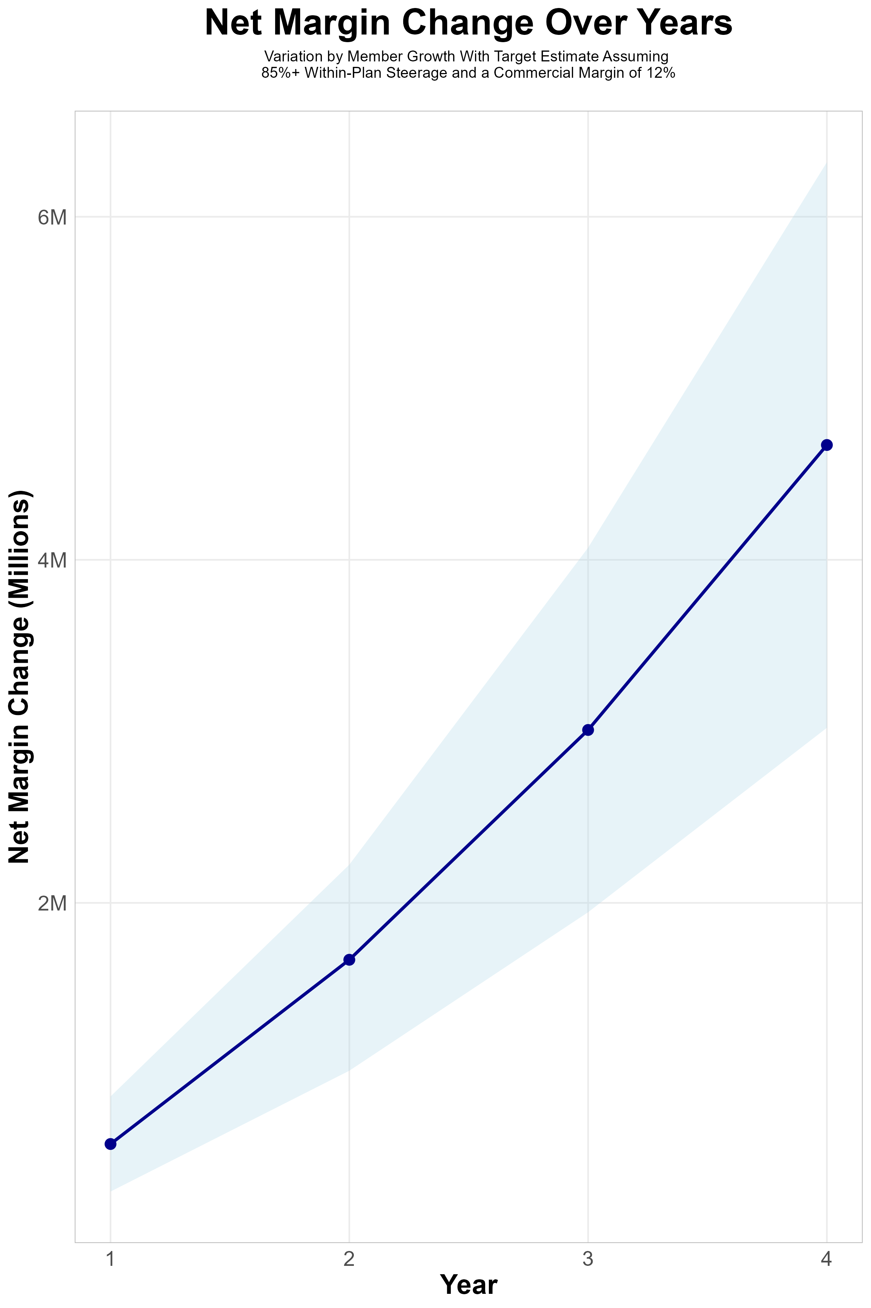
FOUR-YEAR PROJECTIONS
Target Member Growth | Target Member Growth | Target Member Growth | Target Member Growth | Target Member Growth
Metric | Year 1 | Year 2 | Year 3 | Year 4
Number of Members | 1,000 | 2,000 | 3,300 | 5,000
Incremental Margin | 912.1K | 1,824.3K | 3,148.4K | 4,789.4K
Network Access Fee | 12.0K | 24.0K | 39.6K | 60.0K
Implementation Fee (One-Time) | -150.0K | 0.0K | 0.0K | 0.0K
Sales and Marketing Costs | -180.0K | -180.0K | -180.0K | -180.0K
Net Margin Change | 594.1K | 1,668.3K | 3,008.0K | 4,669.4K
High Member Growth | High Member Growth | High Member Growth | High Member Growth | High Member Growth
Metric | Year 1 | Year 2 | Year 3 | Year 4
Number of Members | 1,300 | 2,600 | 4,400 | 6,700
Incremental Margin | 1,185.8K | 2,371.6K | 4,197.9K | 6,417.9K
Network Access Fee | 15.6K | 31.2K | 52.8K | 80.4K
Implementation Fee (One-Time) | -150.0K | 0.0K | 0.0K | 0.0K
Sales and Marketing Costs | -180.0K | -180.0K | -180.0K | -180.0K
Net Margin Change | 871.4K | 2,222.8K | 4,070.7K | 6,318.3K
Low Member Growth | Low Member Growth | Low Member Growth | Low Member Growth | Low Member Growth
Metric | Year 1 | Year 2 | Year 3 | Year 4
Number of Members | 700 | 1,300 | 2,200 | 3,300
Incremental Margin | 638.5K | 1,185.8K | 2,099.0K | 3,161.0K
Network Access Fee | 8.4K | 15.6K | 26.4K | 39.6K
Implementation Fee (One-Time) | -150.0K | 0.0K | 0.0K | 0.0K
Sales and Marketing Costs | -180.0K | -180.0K | -180.0K | -180.0K
Net Margin Change | 316.9K | 1,021.4K | 1,945.4K | 3,020.6K

Slide 15
SINGLE YEAR SUMMARY
DTE Covered Members Financial Analysis | DTE Covered Members Financial Analysis | DTE Covered Members Financial Analysis | DTE Covered Members Financial Analysis | DTE Covered Members Financial Analysis | DTE Covered Members Financial Analysis | DTE Covered Members Financial Analysis | DTE Covered Members Financial Analysis
Target Estimate Assuming 85%+ Within-Plan Steerage and a Commercial Margin of 12%. | Target Estimate Assuming 85%+ Within-Plan Steerage and a Commercial Margin of 12%. | Target Estimate Assuming 85%+ Within-Plan Steerage and a Commercial Margin of 12%. | Target Estimate Assuming 85%+ Within-Plan Steerage and a Commercial Margin of 12%. | Target Estimate Assuming 85%+ Within-Plan Steerage and a Commercial Margin of 12%. | Target Estimate Assuming 85%+ Within-Plan Steerage and a Commercial Margin of 12%. | Target Estimate Assuming 85%+ Within-Plan Steerage and a Commercial Margin of 12%. | Target Estimate Assuming 85%+ Within-Plan Steerage and a Commercial Margin of 12%.
DTE Members | Pre-DTE Revenue | Pre-DTE Margin | DTE Revenue | DTE Incr. Revenue | DTE Total Margin | DTE Incr. Margin | Net Margin Less DTE Fees
100 | $ 279K | $ 33K | $ 726K | $ 447K | $ 123K | $ 90K | $ -239K
500 | $ 1,395K | $ 167K | $ 3,632K | $ 2,237K | $ 617K | $ 450K | $ 126K
1,000 | $ 2,790K | $ 335K | $ 7,264K | $ 4,474K | $ 1,235K | $ 900K | $ 582K
2,500 | $ 6,974K | $ 837K | $ 18,160K | $11,186K | $ 3,087K | $ 2,250K | $ 1,950K
10,000 | $27,897K | $3,348K | $ 72,642K | $44,744K | $12,349K | $ 9,001K | $ 8,791K
20,000 | $55,794K | $6,695K | $145,283K | $89,489K | $24,698K | $18,003K | $17,913K

Slide 16
Year 4 Projected Revenue and Profit
Pre-DTE Cohort of 5,000 Employees | Inpatient | Outpatient | Professional | Total
Revenue† | $ 6,844,470 | $ 4,842,660 | $ 2,261,481 | $ 13,948,611
Net Income‡ | $ 821,336.4 | $ 581,119.2 | $ 271,377.7 | $ 1,673,833
† Assuming proportional revenues from market shares of 50% (inpatient) and 19% (outpatient)
‡ Conservatively assuming a commercial margin of 17% (80% of the estimated commercial margin)
With DTE | Inpatient | Outpatient | Professional | Total
Revenue⁰ | $ 10,605,598 | $ 18,446,406 | $ 8,614,315 | $ 37,666,318
Net Income* | $ 1,802,952 | $ 3,135,889 | $ 1,464,434 | $ 6,403,274
⁰ Assuming 77% inpatient and 74% market steerage based on KBA narrow network DTE experience (see previous slide)
* Conservatively assuming a commercial margin of [MM]%, with a 10 percentage-point reduction to reflect competitive-edge rates and a 10 percentage-point increase due to lower billing costs and higher patient responsibility collections because of the member credit card.
Total Increase in Net Income | $ 4,729,441
Network Access Fee (Revenue) of $1 PMPM | $ 60,000
Total Profit Growth | $ 4,734,241
Minus Implementation Fee (One-Time) | -$ 0
Minus Sales and Marketing (Annual – Ongoing) | -$ 180,000
Total | $ 4,609,441

Slide 17
The Win/Win of Cutting Out the Middle Man
Healthcare Delivery Costs Are Able to Continue to Grow
Employers See Dramatically Lower Overall Healthcare Costs

Slide 18

Traditional Value-Based Care is Backwards
Employers/payer and ACO provider organization spend millions forecasting and contracting for value-based care, negotiating about capitation, metrics, reporting periods and quality measurements.
ACO provider organizations deliver care constantly encumbered by new metrics. Team cost millions watching and optimizing on the metrics.
ACO provider organizations are solely responsible for patient engagement.
Messy assessments of metrics determine financial outcomes.
Both the ACO provider organizations and the employers/payer find very little value and discontinue this effort.

Slide 19

DTE’s Enable True Value-Based Care
Employers Choose Maine Street Health because they trust the provider organizations.
Providers in Maine Street Health have the flexibility to deliver exemplary care at a value price.
Employers and provider organizations work together to engage employee members.
Employer loyalty deepens. Employee health improves. Providers see financial gains.

